Slide 1



Doing Business with Hernando County
PROCUREMENT 101
Vendor Edition

Slide 2
Purchasing and procurement
Promote Fair and Open Competition
Ensure that public funds are expended in a way that provides maximum benefit to our taxpayers
Ensure compliance with State Statues, County Ordinance, and Hernando County Board polices
Obtain necessary commodities and services required by all Hernando County BOCC departments to fulfill their responsibilities to the County

Slide 3
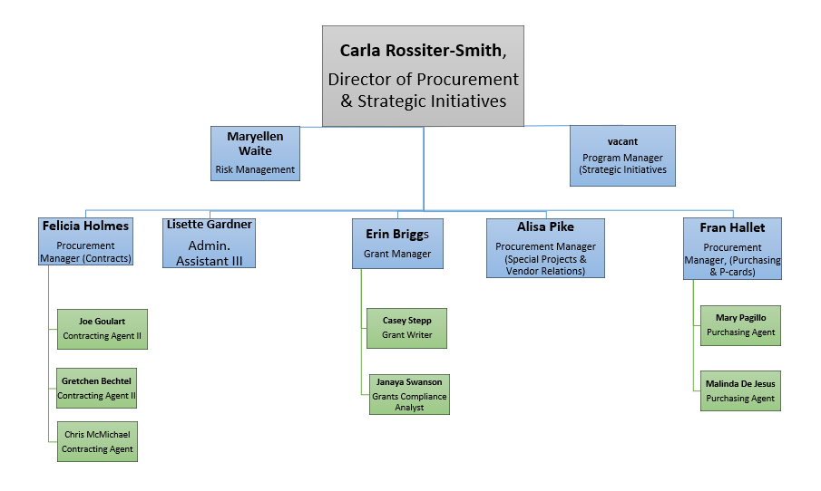

Slide 4
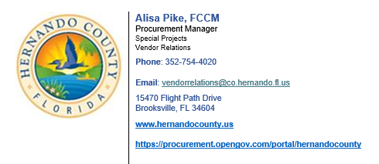
MEET THE TEAM
Vendor Relations

Slide 5
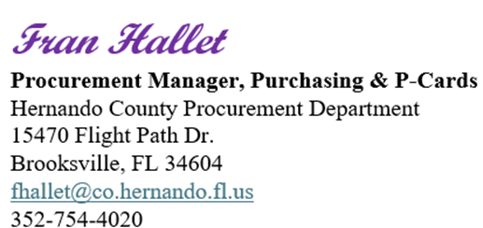
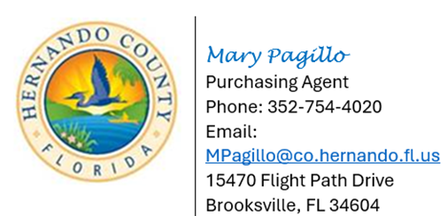
MEET THE TEAM
Purchasing, P-Cards, Piggyback Contracts

Slide 6

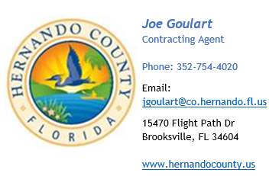
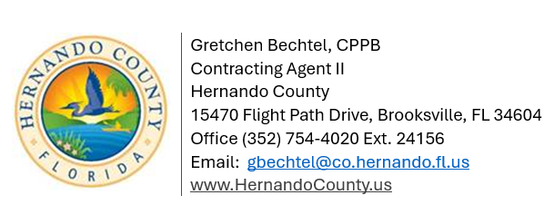
Contracts
MEET THE TEAM

Slide 7
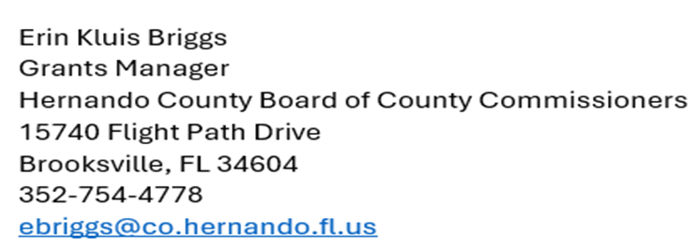
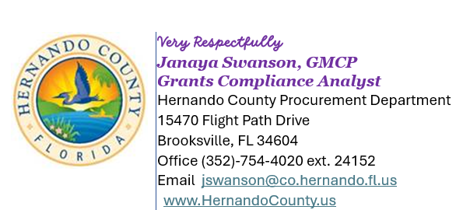

Grants
MEET THE TEAM

Slide 8

Risk Management
MEET THE TEAM

Slide 9
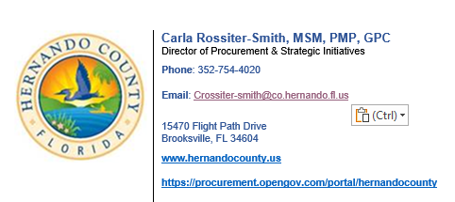
Chief Procurement Officer
MEET THE TEAM

Slide 10
Purchasing Thresholds
$5,000.00 and Under
one WRITTEN quote or use OF County Purchasing Card
NO TRANSACTION OR PROCESSING FEES ALLOWED
$5,000.01 - $50,000.00
three WRITTEN quotes directly from vendors (“apples to apples”) and award to the lowest quote received
$50,000 OR OVER
$50,000 IS A NUMBER PENDING ON THE NATURE OF THE PURCHASE – can be less or more
Formal Sealed Solicitations:
Invitation to Bid (ItB),
Request for Proposal (RFP),
Request for Qualifications (RfQ),
Purchases of $50,000 OR OVER:
Approved by the Hernando County Board of County Commissioners

Slide 11
Types of Formal Solicitations
Invitation TO Bid (ITB) or term contract
Used when the department can define the scope of work and specifications for goods and services.
Award is made to the lowest, responsive, and responsible bidder.
Request for Qualifications (RFQ)
An evaluation committee is appointed to review and evaluate proposals submitted based on prior established criteria. NO PRICE IS SUBMITTED OR CONSIDERED during evaluation. Final pricing negotiated with top-ranked firm. Only one firm may be negotiated with at any given time, and if no agreement is reached with top-ranked firm, negotiations can begin with next highest ranked firm and so on.
REQUEST FOR PROPOSALS (RFP)
A REQUEST FOR PROPOSAL IS USED TO OBTAIN GOODS AND SERVICES BASED ON A SCOPE OF WORK PROVIDED BY THE USER DEPARTMENT. AN EVALUATION COMMITTEE IS APPOINTED TO REVIEW AND EVALUATE PROPOSALS SUBMITTED BASED ON PRIOR ESTABLISHED CRITERIA WHICH MAY INCLUDE BUT IS NOT LIMITED TO PRICE.

Slide 12
OTHER Type of PROCUREMENT
Piggyback:
The Purchasing Ordinance does allow for the use of State/ Cooperative Contracts, or “Piggybacking” of other public agency contracts, when in the best interest of Hernando County.
Because these contracts are competitively solicited, the public procurement process is still being fulfilled.
TERM CONTRACT – ITB (Invitation to Bid)
We use ITBs when we can establish precise specifications defining the actual commodity or commodities required.
A term contract is an agreement between a customer and a supplier that sets out the terms of the relationship between them. The contract will specify the products or services to be supplied, the price, the delivery schedule, and any other terms and conditions of the agreement.

Slide 13
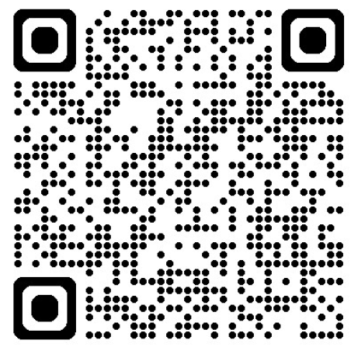
How Do I find out about projects ?
All Hernando County Solicitations documents are posted on the OpenGov online platform:
https://procurement.opengov.com/portal/hernandocounty.
You may also find the link by visiting procurement on the Hernando county webpage:
https://www.hernandocounty.us/departments/departments-n-z/procurement/solicitations.
It is free!
Would you like to Digitally engage and connect with your local government online?
Engage Hernando
You may find the link by visiting engage on the Hernando county webpage:
https://www.hernandocounty.us/our-county

Slide 14
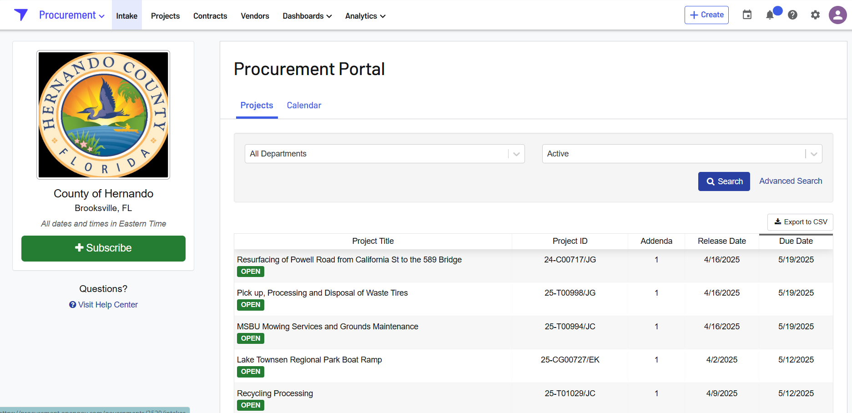
Opengov view

Slide 15
How Do I find out about projects ?
Attend Hernando County’s meet & greet events!
Use opengov’s “coming soon’ feature!
Use opengov’s calendar feature!

Slide 16
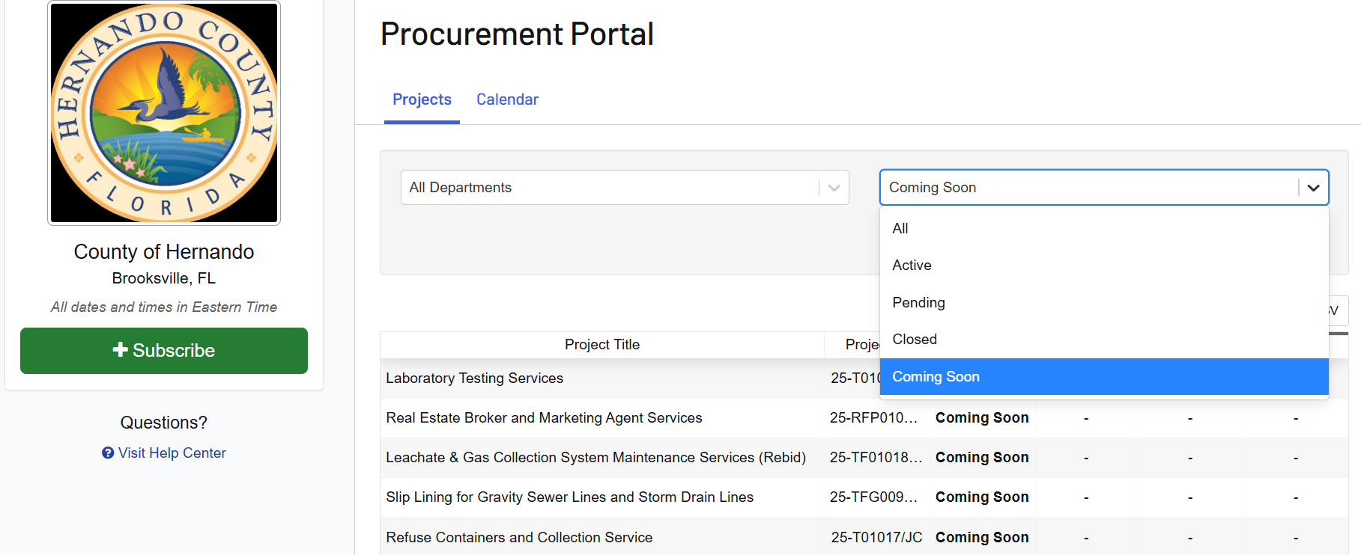
The “coming soon” feature

Slide 17
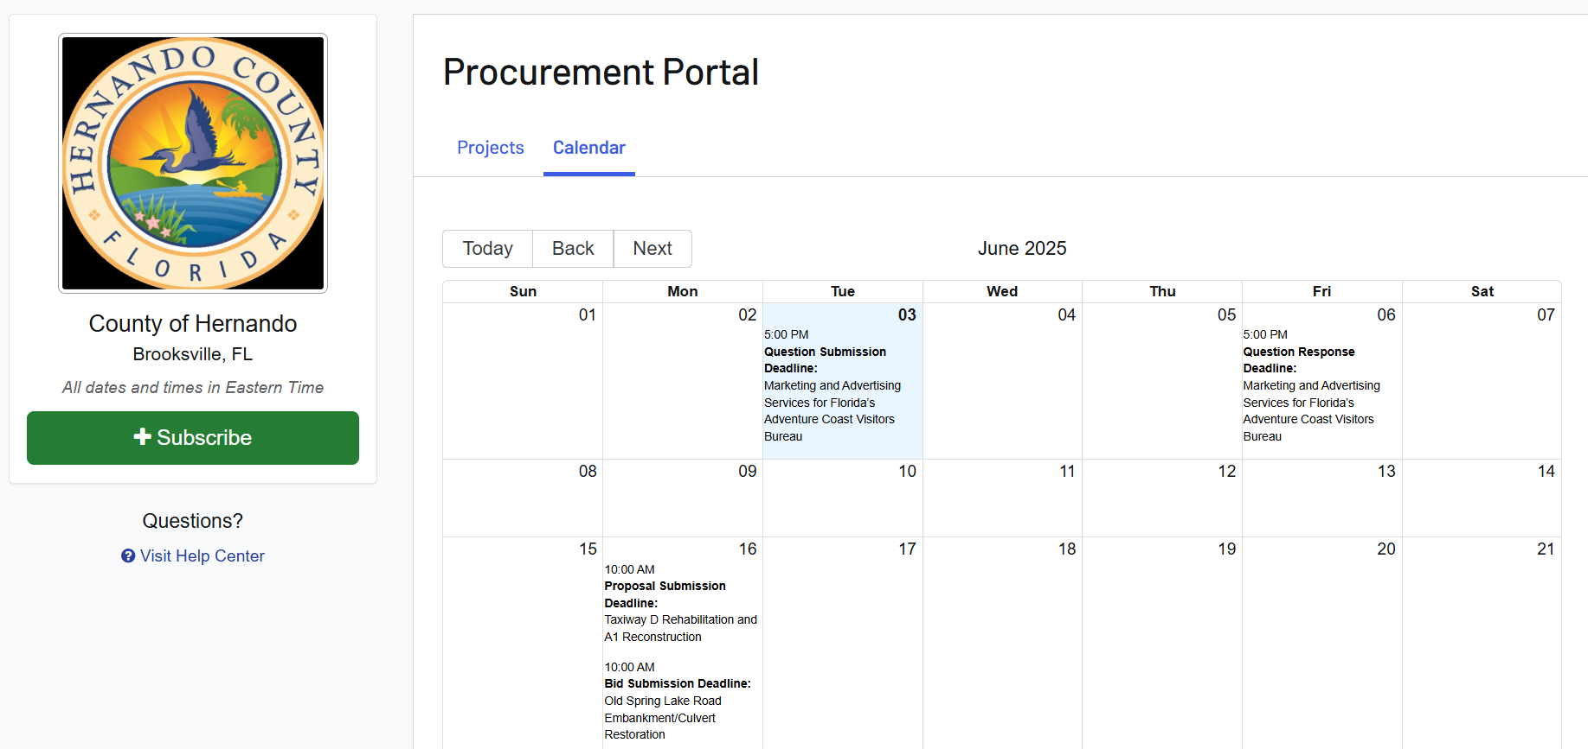
The “ calendar” feature

Slide 18

Doing business in hernando?
The Hernando Office of Economic Development is a strategic partner in business success, connecting businesses with essential resources at local, regional, and statewide levels.
If you need support building a business or marketing plan, recruiting and retaining employees, developing specialized training programs, or accessing export assistance, we can guide you to the right solutions.
We can connect you with the experts who help turn business goals into reality.
We can connect you with the experts who help turn business goals into reality!

Slide 19
Helpful Solicitationreview hints and opengov Tips​
Read ALL solicitation documents thoroughly from beginning to end.
Take note of your overview page in OpenGov!
Important dates – bid closing, pre-bid meetings, question deadlines, etc..
Prebid meeting details – address, if mandatory or not
** PLEASE NOTE: If meeting is mandatory and you do not attend, you will not be able to submit a bid for that project **
ASK QUESTIONS – if you are unsure of any language in the solicitation docs, the specifications, or unsure of any requirements, submit your questions in OpenGov prior to question deadline date.
CHECK FOR ADDENDUMS – All questions submitted will be answered via an Addendum on OpenGov. Addendums will also include any changes that Hernando may need to make to the solicitation's docs, so it is important to look out for those notifications to ensure your bids are accurate.

Slide 20
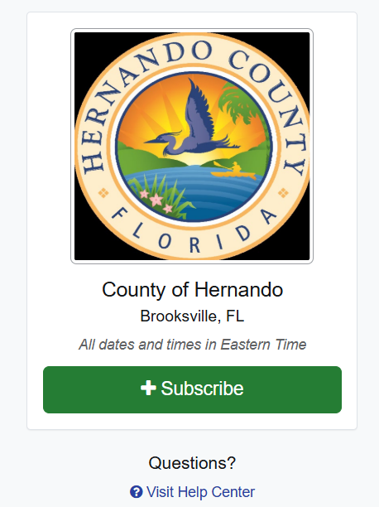
Helpful Solicitation review hints and opengov Tips​
Familiarize yourself with using and navigating opengov. tutorials and helpdesk assistance are available online as well as via telephone.
Do not wait until last minute to submit your bid or proposal to avoid encountering any technical or connectivity issues!
Provide yourself enough time to troubleshoot any technical difficulties.
Be thorough and cross your t’s and dot your I’s. Ensure that all documents requiring signatures and notary are filled out completely.
Check your e-mail frequently and don’t forget to look in the e-mail junk folder for any outreach from procurement staff or opengov notifications.

Slide 21

Helpful Solicitation review hints and opengov Tips​
FOLLOW THE PROJECTS –
you must be a follower of a project in opengov
in order to receive updates and deadline reminder e-mails!

Slide 22
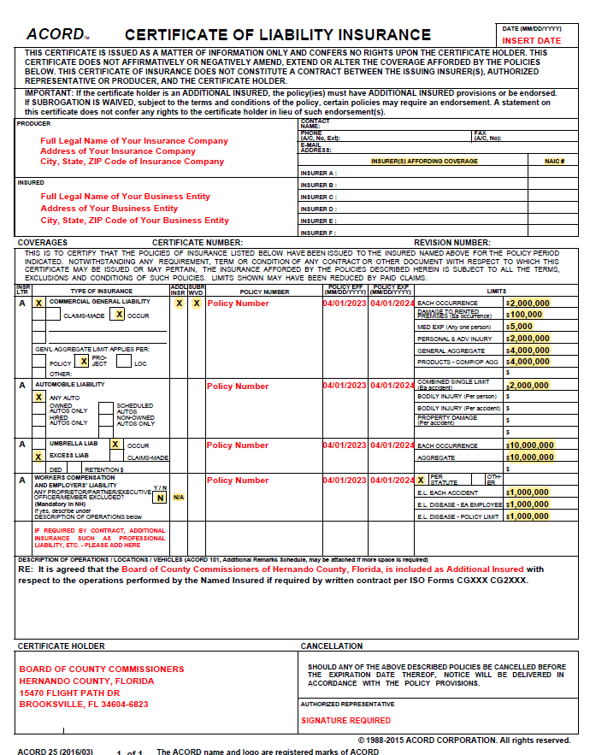
Insurance Information
Without it,
Contracts cannot be awarded
Purchase Orders cannot be issued

Slide 24
Bonding Information
Bid Bonds – for construction only
Bid offers shall be accompanied by either a Bid Bond, Certified Check, Cashier's Check, or Official Bank Check in the dollar amount representing not less than five percent (5%) of the total amount bid as a guarantee to enter into a contract and furnish a contract performance and payment bond in the amount of one hundred percent (100%) of the total bid price within fifteen (15) calendar days from the date of notification of the award.
Is assurance that the bidder is serious and will enter into a contract with the County in a timely manner.
Should this fail – Bid Bond can be retained by County to cover costs of finding a new vendor for the contract.

Slide 25
Bonding Information
Payment and Performance Bonds act as assurance that the work will be completed and subtractors will be paid.
Is required on most construction projects and some smaller projects (Requirements will be found in the front-end documents of the solicitation)
Required by Florida Statue when construction exceeds $200,000. Sometimes called Public Construction Bonds.
Must be official recorded at the Hernando County Clerk of Circuit Court.
Performance and Payment bonds in the amount of one hundred percent (100%) of the total bid price are due within fifteen (15) calendar days from the date of notification of the award.
Please note: Dates listed on the Performance and Payment Bonds cannot precede the date of the BOCC approval date!

